Slide 1

Picking Right Location For a New Restaurant in Berlin

Slide 2
INTRODUCTION
01
Modern PowerPoint Presentation
Easy to change colors, photos and Text.
PROBLEM DEFINITION
02
Modern PowerPoint Presentation
Easy to change colors, photos and Text.
METHODOLOGY
03
Modern PowerPoint Presentation
Easy to change colors, photos and Text.
RESULTS
04

Slide 3
INTRODUCTION
The IBM Data Science Professional certificate course on Coursera concludes with a Capstone Project. This project is about using data science toolset on a real-life problem and demonstrating the creation of value by applying the learned skills. This report presents the capstone project which is done for picking right location for a new restaurant in Berlin.

Slide 4

PROBLEM
Berlin is the capital and largest city of Germany by both area and population. In an competitive field, Berlin is making a strong claim to be the world’s premier city. The German capital can lay claim to reasonable rent, an English-speaking population, thriving businesses, great food and nightlife, and a burgeoning startup scene.
In here, business problem is to picking up a best location to open a new restaurant in Berlin. Taking the population, price level at which the restaurant will operate. The intent is to find an optimal location in an area which is easily accessible for tourists and for wealthier local citizens as well.
This analysis could be useful for group of market players and businesspeople who have idea to open new restaurant in berlin and also tourists to take idea about restaurants around Berlin

Slide 5

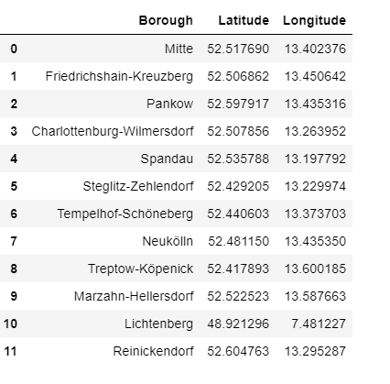
METHODOLOGY
To perform this analysis , following data required:
List of the boroughs and neighborhoods of Berlin
Geo-coordinates of the boroughs in Berlin
Top venues of boroughs
List of boroughs will be obtained from Wikipedia.
(https://en.wikipedia.org/wiki/Boroughs_and_neighborhoods_of_Berlin)
There are 12 boroughs in the Berlin and this table shows the corresponding longitude and latitude values for each borough.

Slide 6
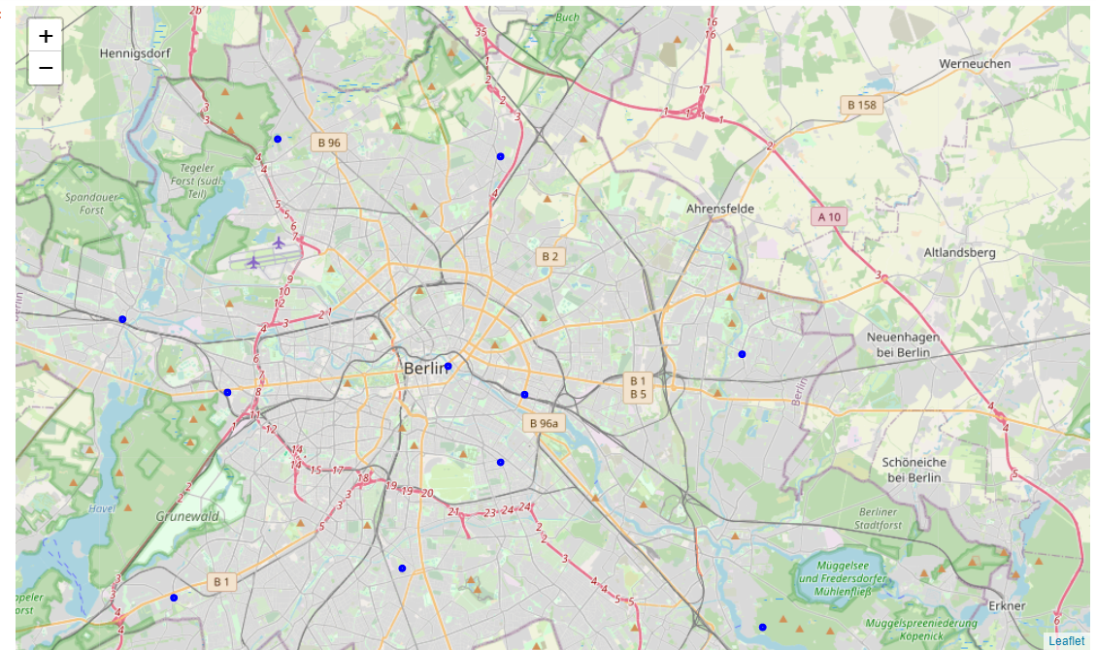
After exploring the data , K – Means clustering will be applied for creating clusters of boroughs. Silhouette score can be used for selecting the optimal number of clusters
Boroughs of Berlin

Slide 7
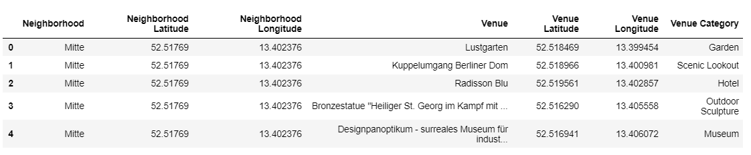
In the next step of analysis , the boroughs were explored in greater detail. It means venues were collected for each borough via Foursquare API. The data from Foursquare is received in JSON format. After arranging the data , 100 venues for each borough were captured. Venues are collected within a radius of 1000 meters from the point of borough coordinates. The collected and arranged data looks like this.

Slide 8
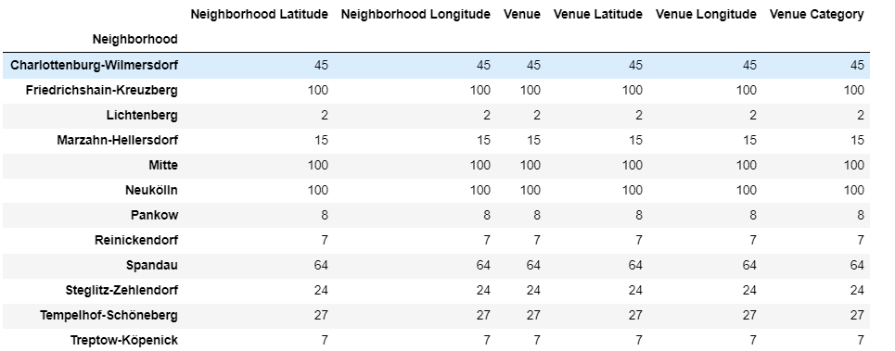
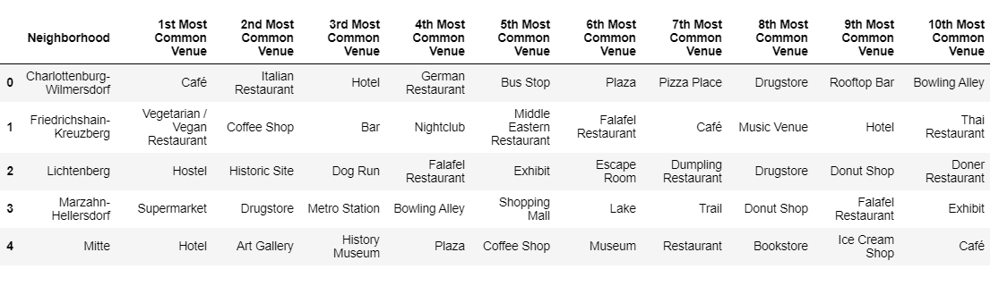
Following table gives the summary for each neighborhood
For analysis the boroughs , only venue categories are focused. Following table shows the results of top ten most common venues for each borough after manipulations with the dataset

Slide 9
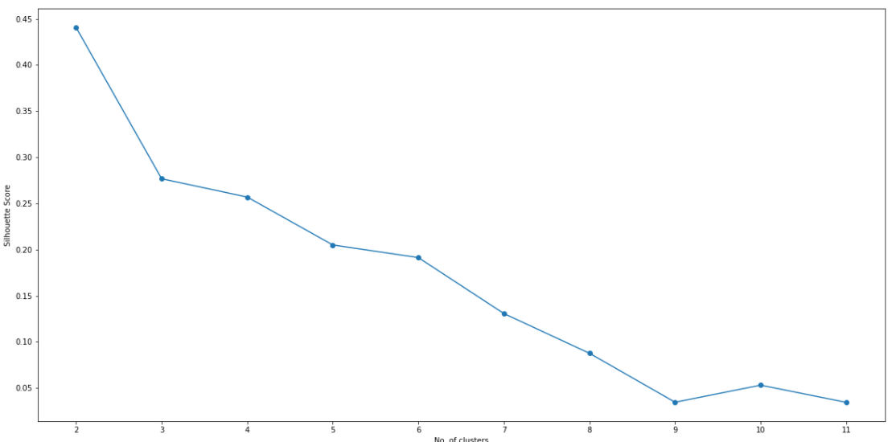
Now clustering is performed. Here K - Means algorithm is mainly used which is unsupervised learning method. In order to select best number of cluster we can use the graph which shows the silhouette scores with different number of clusters
According to the graph , optimal number of cluster is 2 which gives the highest score

Slide 10
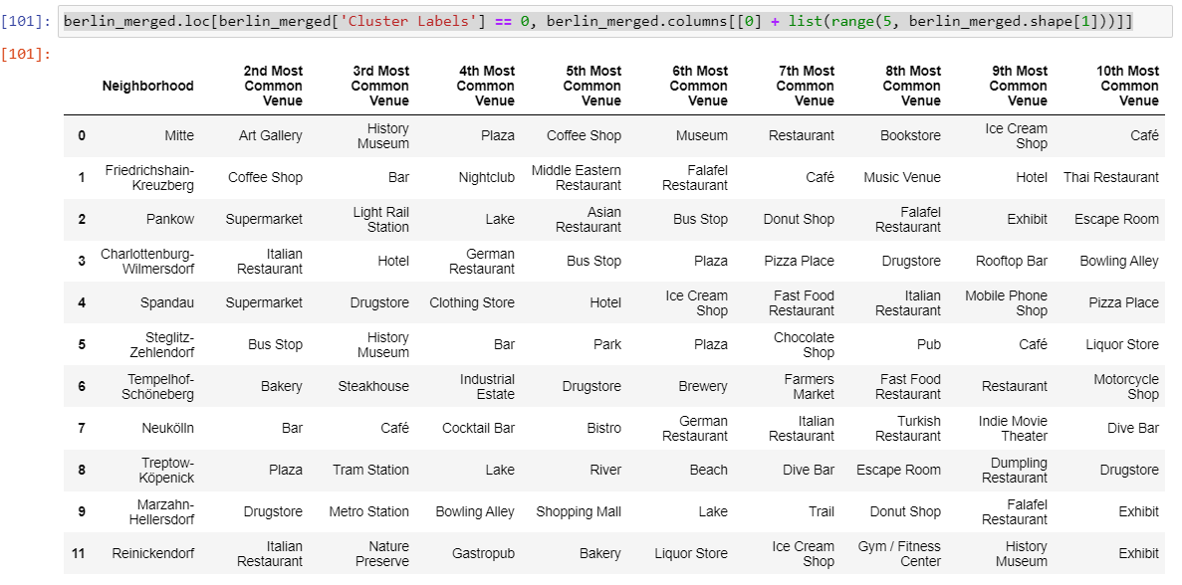
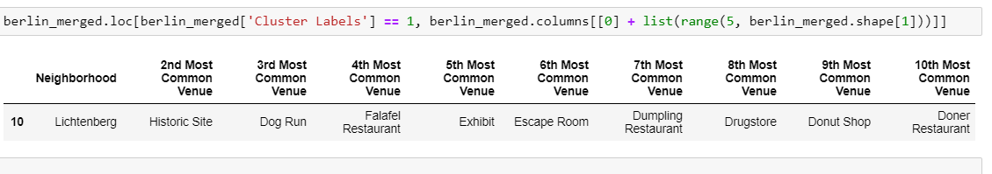
RESULTS
Cluster 0
Cluster 1

Slide 11
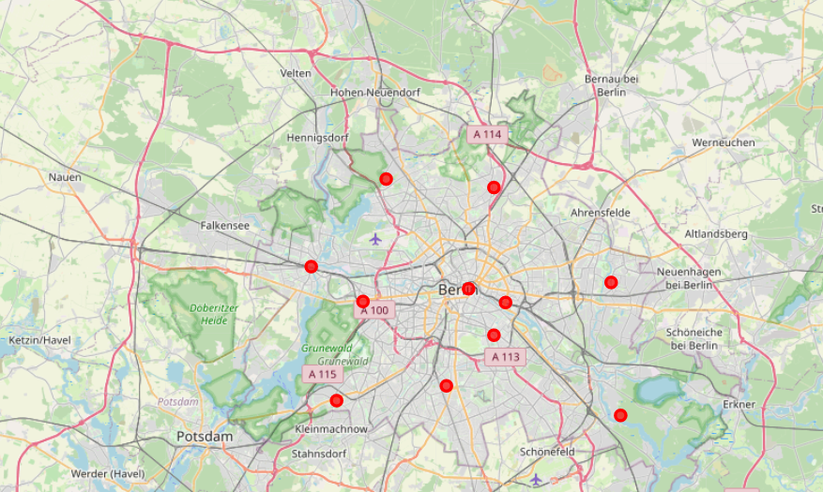
Based on cluster details , we can advise businessman to open new restaurant in boroughs which are related to cluster 0. There are lots of similar places in this cluster and will have a potential location for a new restaurant

